Slide 1
1 EDS Basic Search

Slide 2
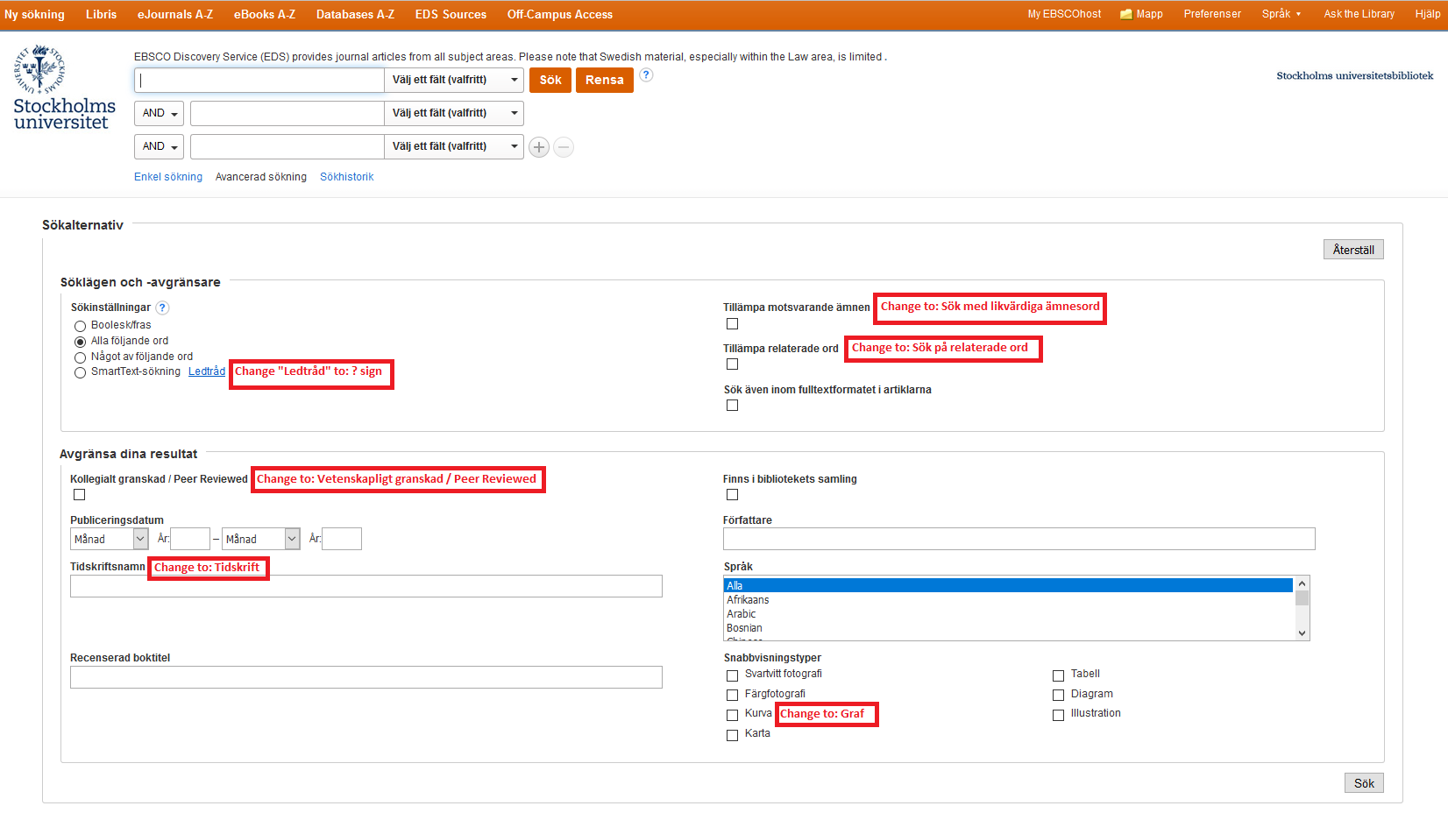
2 EDS Advanced Search

Slide 3
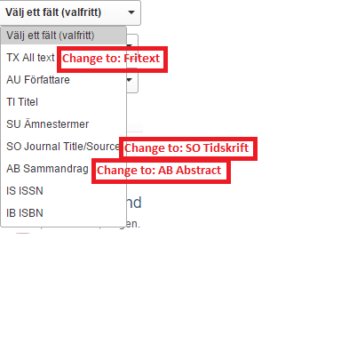
3 EDS Advanced Search_droplist_Select a Field (optional)

Slide 4
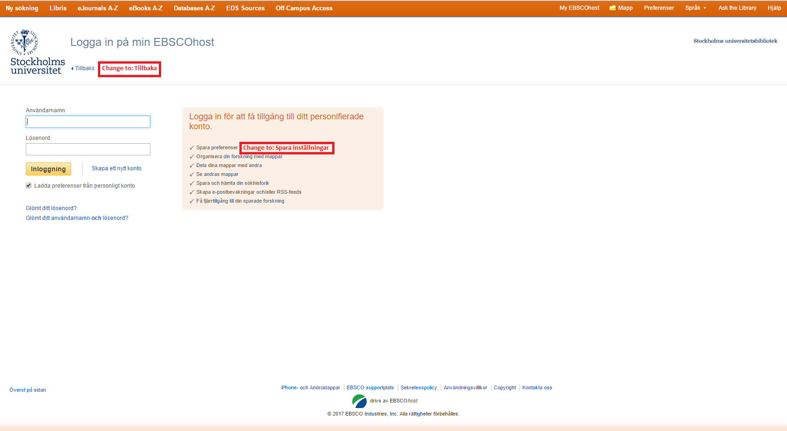
4 EDS Top menu_My EBSCOhost

Slide 5
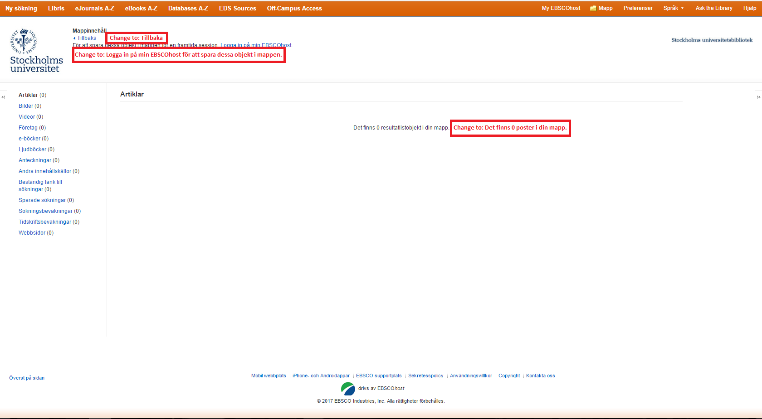
5 EDS Top menu_Folder

Slide 6
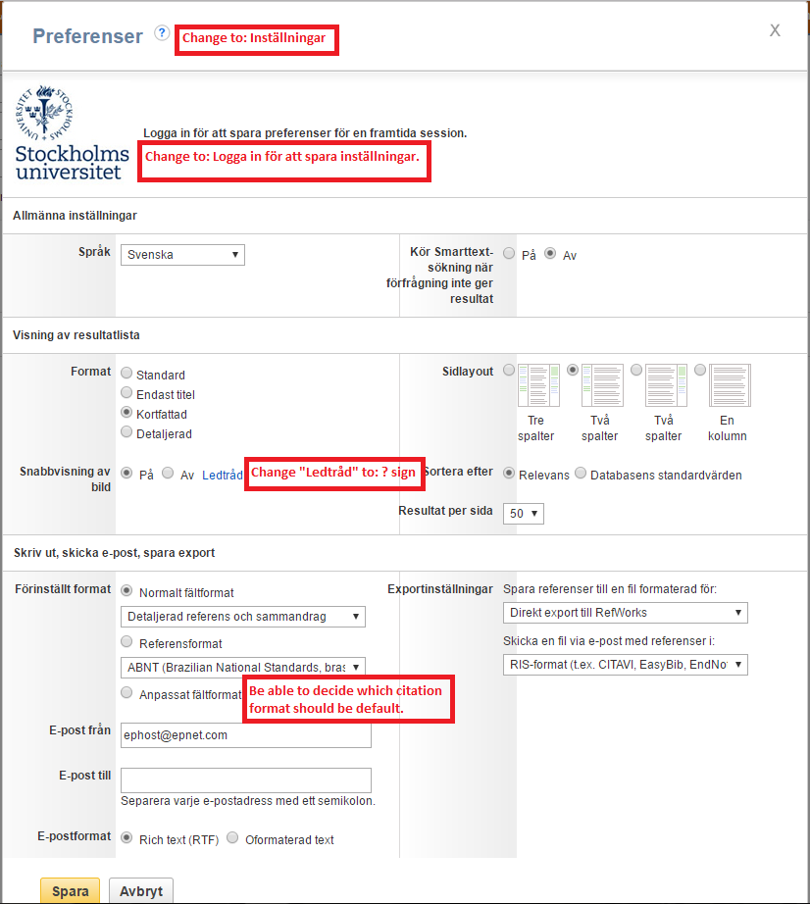
6 EDS Top menu_Preferences

Slide 7
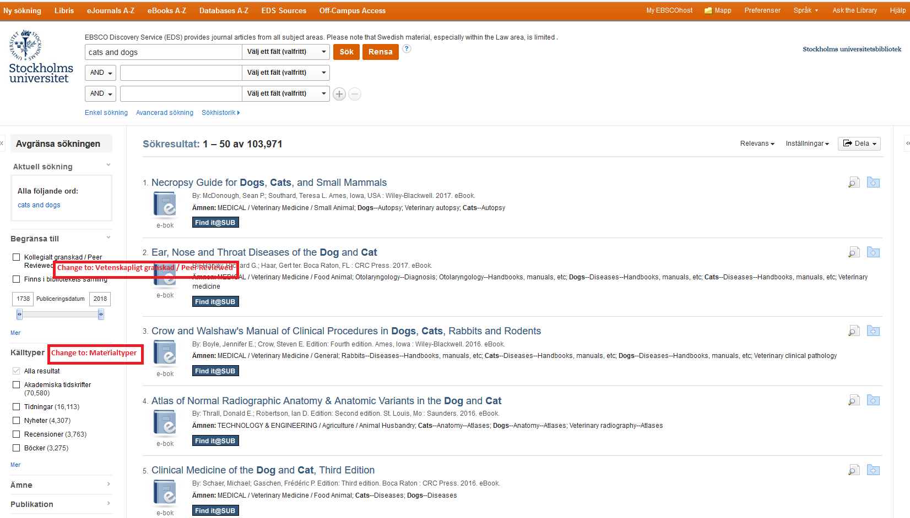
7 EDS Search Results

Slide 8
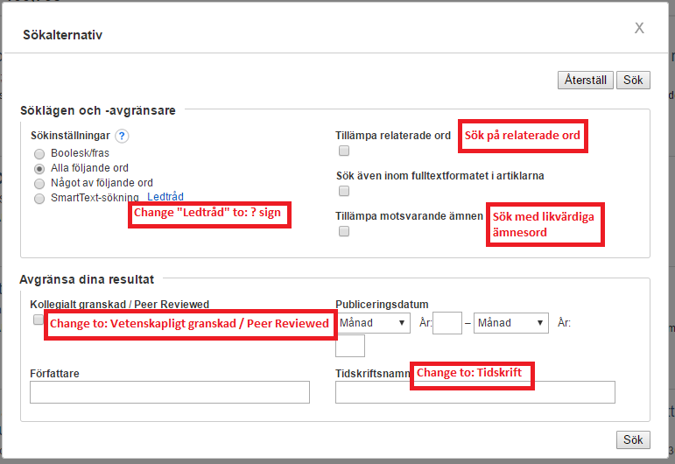
8 EDS Search Results_Limit To

Slide 9
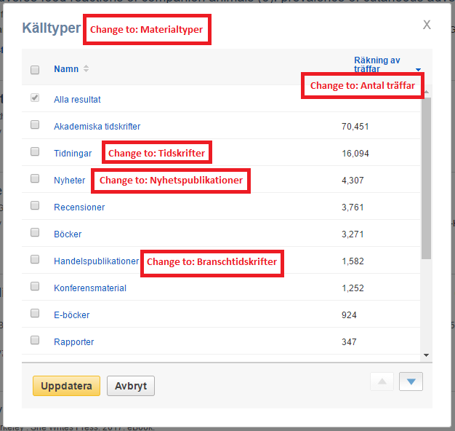
9 EDS Search Results_Source Types

Slide 10
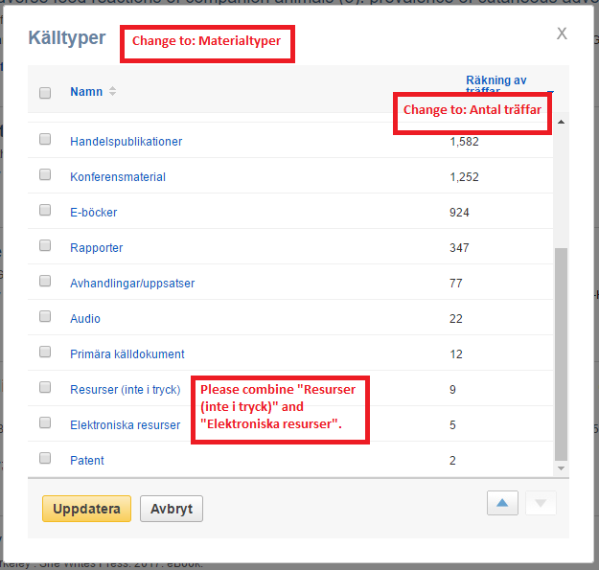
10 EDS Search Results_Source Types_continuing

Slide 11
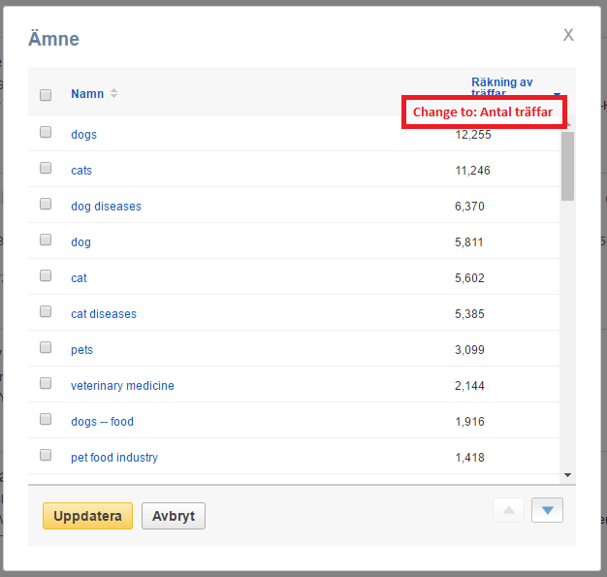
11 EDS Search Results_Subject

Slide 12
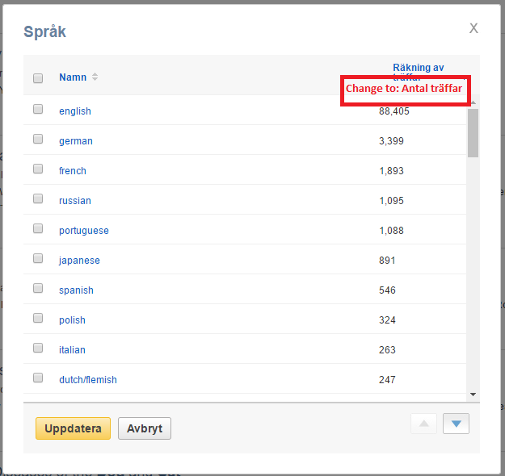
12 EDS Search Results_Language

Slide 13
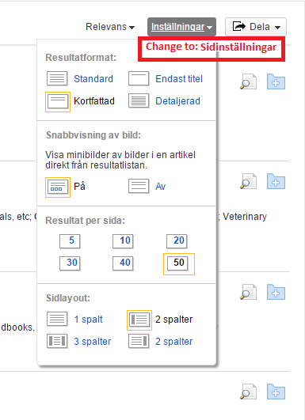
13 EDS Search Results_Page Options

Slide 14
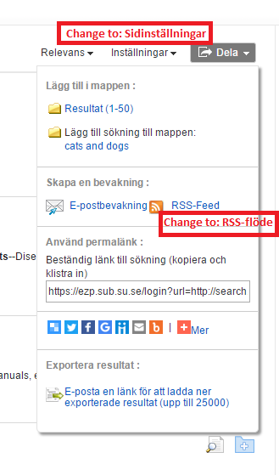
14 EDS Search Results_Share

Slide 15
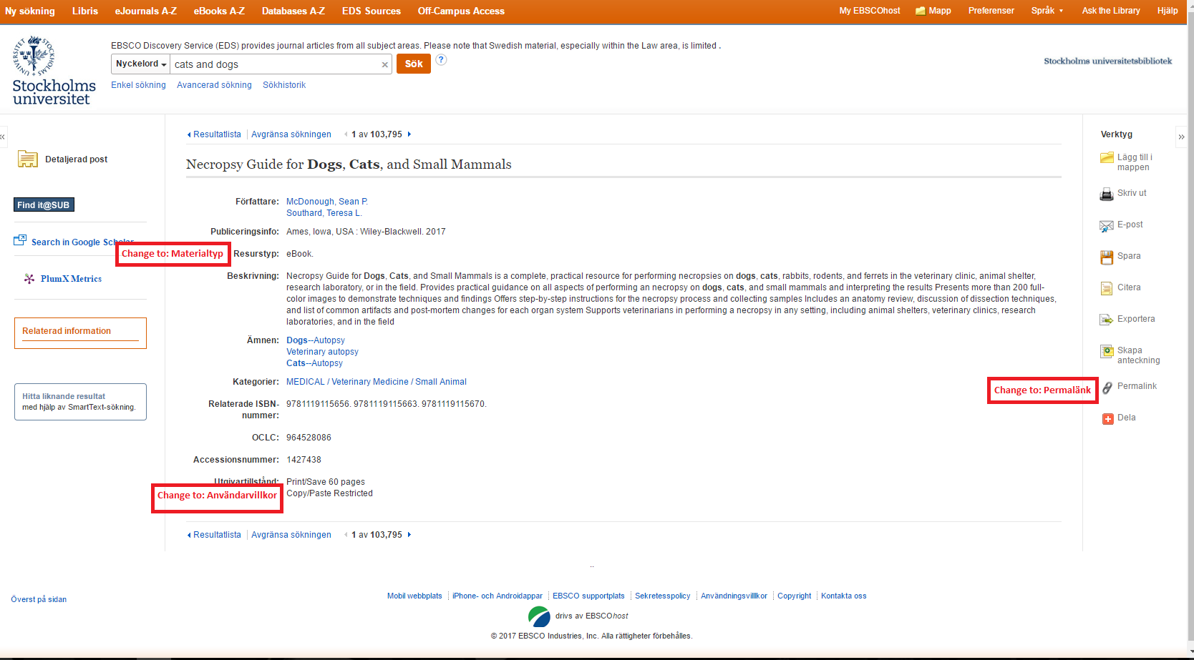
15 EDS Detailed Record

Slide 16
16 EDS Detailed Record_Print

Slide 17
17 EDS Detailed Record_E-mail

Slide 18
18 EDS Detailed Record_Save

Slide 19
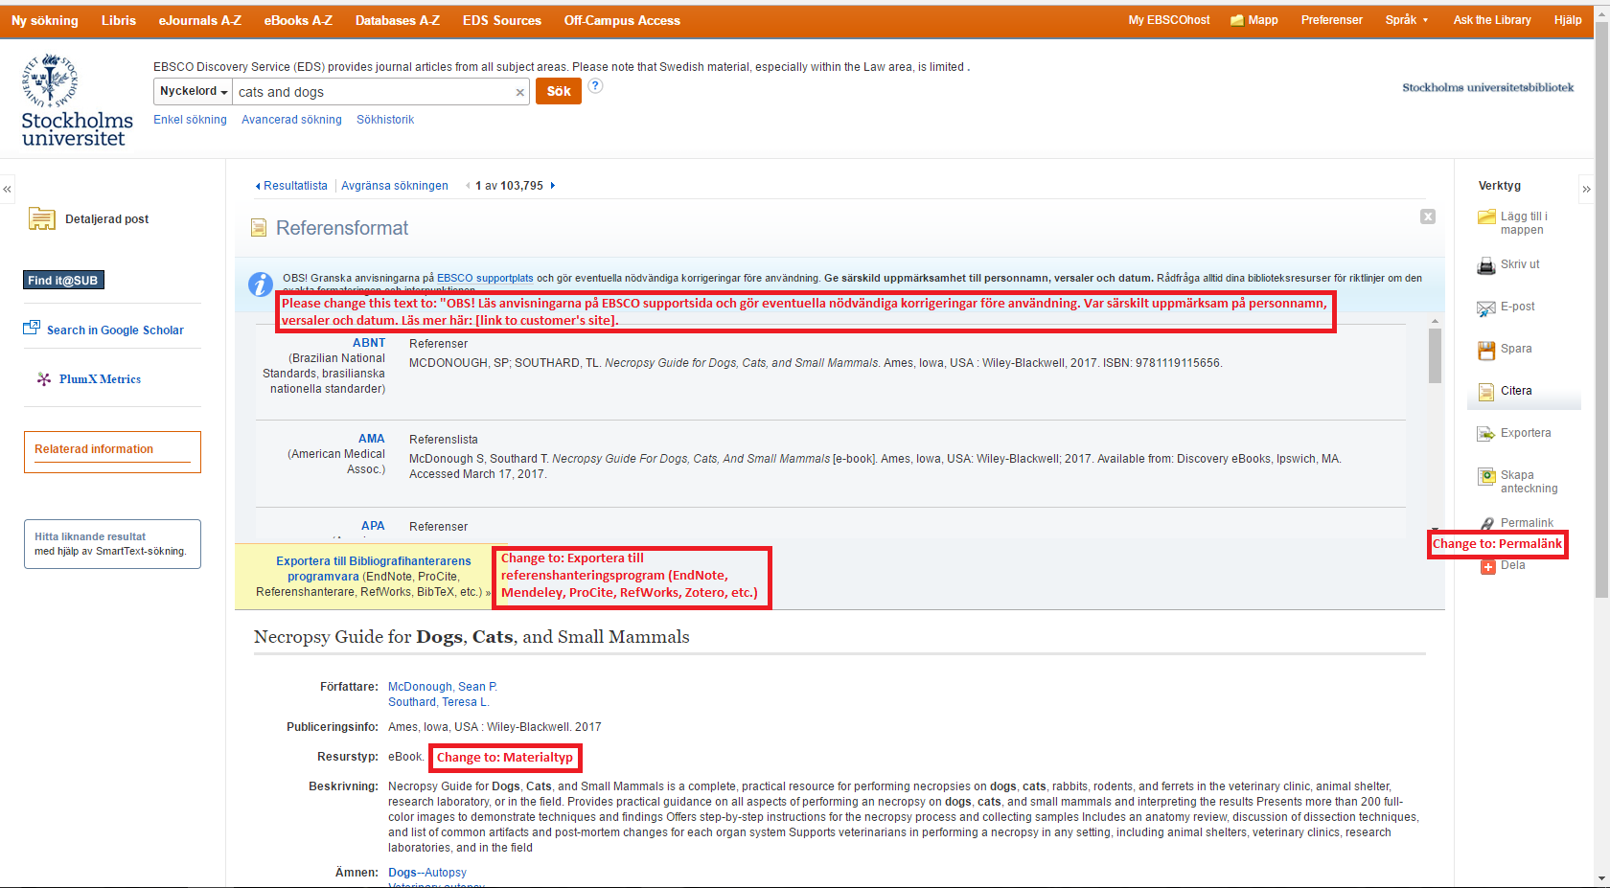
19 EDS Detailed Record_Cite

Slide 20
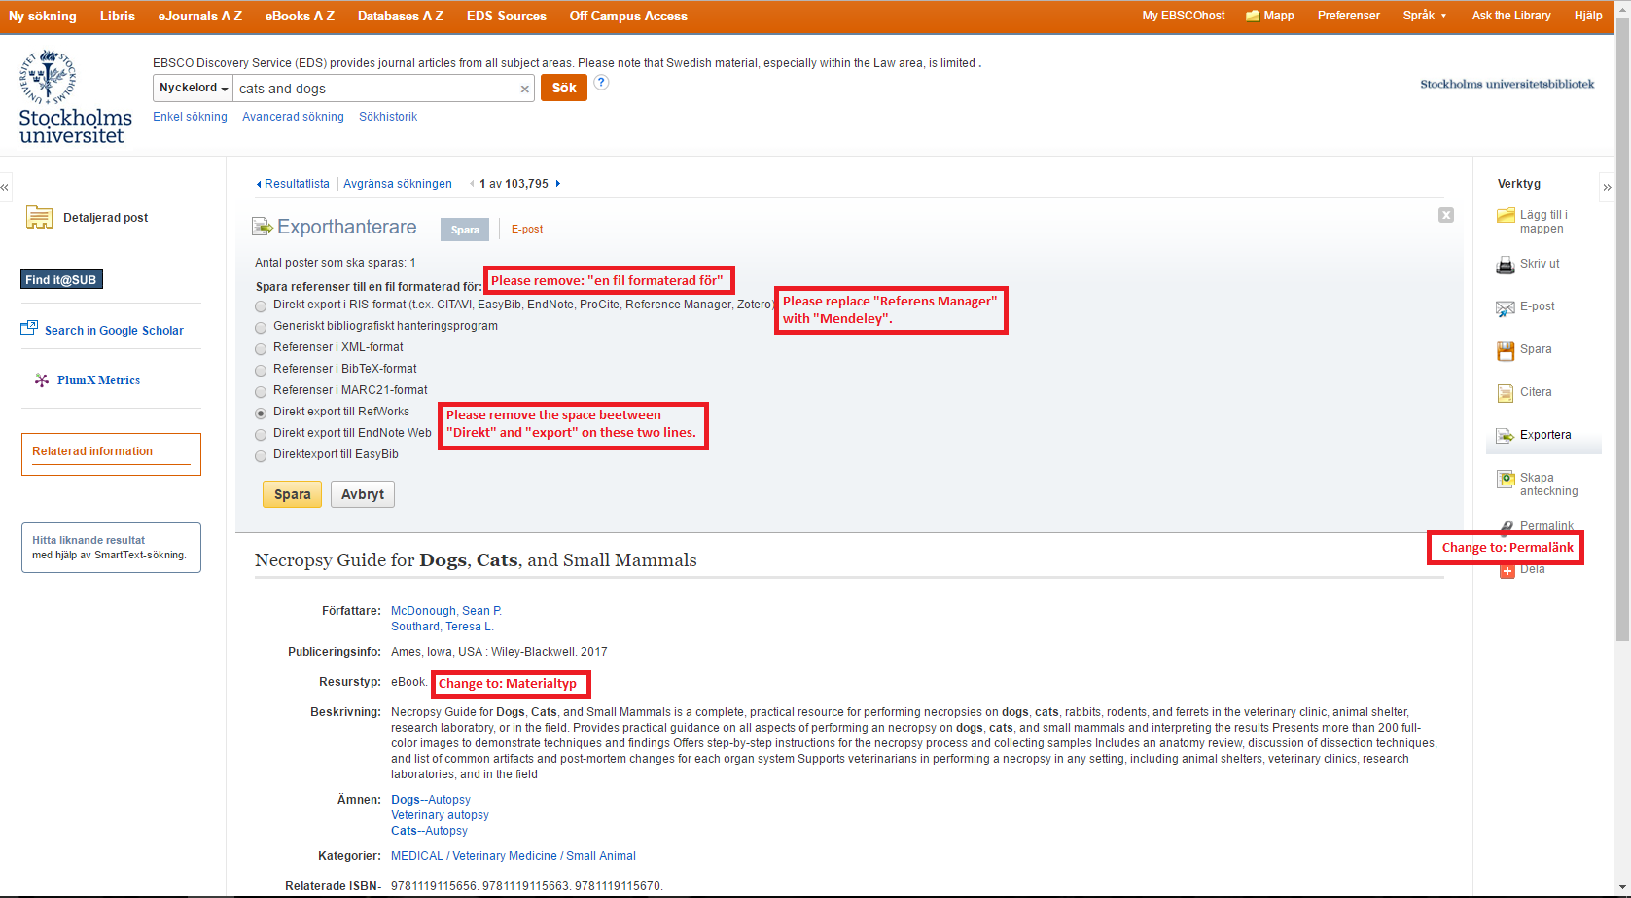
20 EDS Detailed Record_Export

Slide 21
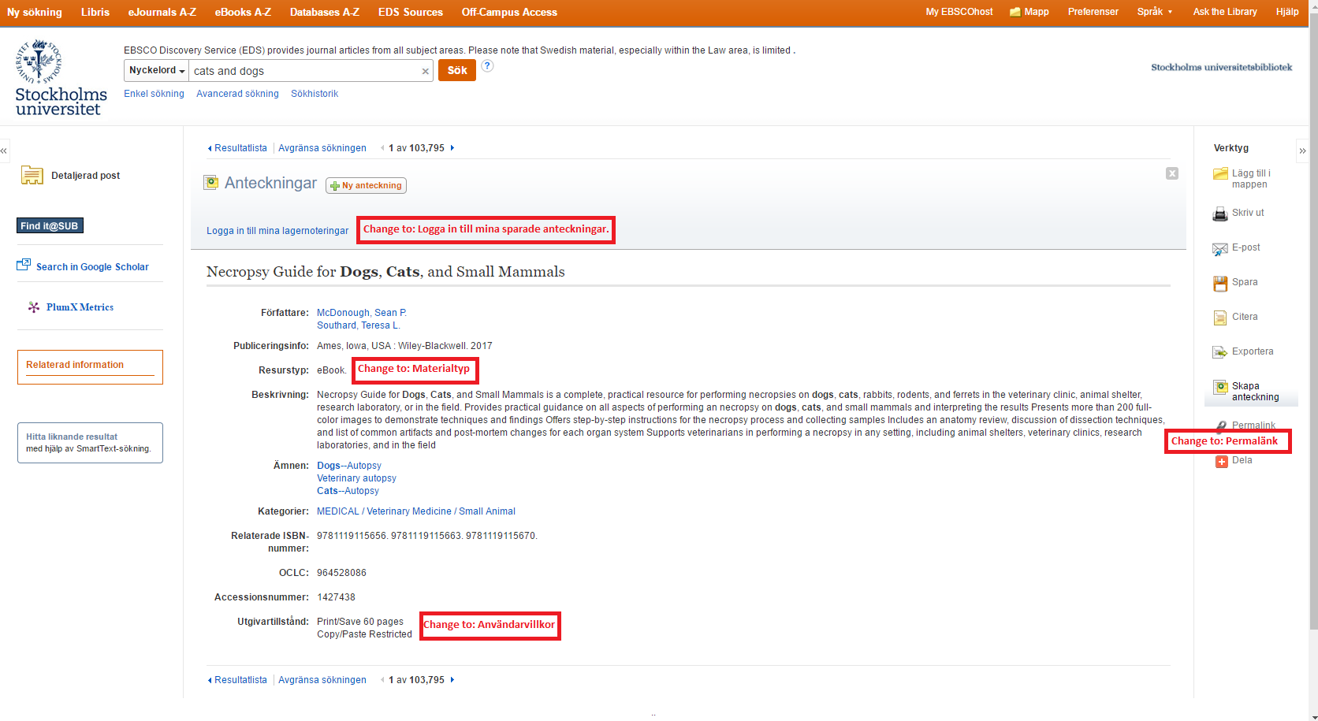
21 EDS Detailed Record_Create Note

